Slide 1
Assessing the Feasibility of your Research and Discoveries
Using a framework for rapidly assessing the commercial feasibility of an idea, technology or research discovery.
Professor Damian Hine
University of Queensland
Bandung Conference
September 2018

Slide 2
Let’s clear up some misconceptions.

Slide 3
Misconception #1:
Innovation is hard
Innovation is actually a creative process.
Research is also often a social process.
Innovation is the outcome of research and inventive effort.
So innovation should be enjoyable.
You should actually employ a creative process even after the point of discovery – you have to innovate in everything you do.

Slide 4
Misconception #2:
Commercialisation is complex and requires specific professional skills that researchers don’t possess.
There is nothing mystical about commercialisation.
It is largely common sense and basic management – financial management, patent and other IP searches, market research, accounting, project management, future planning, research on competitors and simple logic around stages of development.
It doesn’t require a business, economics or finance degree to understand.

Slide 5
Misconception #3:
Researchers should not attempt to commercialise their own inventions.
Once you pull back the veil of secrecy and obfuscation over commercialisation you realise that it is not very different to your normal research work.
In fact if you employ the scientific method you will understand the commercialisation process quite easily

Slide 6
A commercialisation framework that you can use yourself.
Based on many years’ experience working with technologies, with researchers and with students, I have designed a commercialisation framework that is not difficult to understand and can be used by anyone.

Slide 7
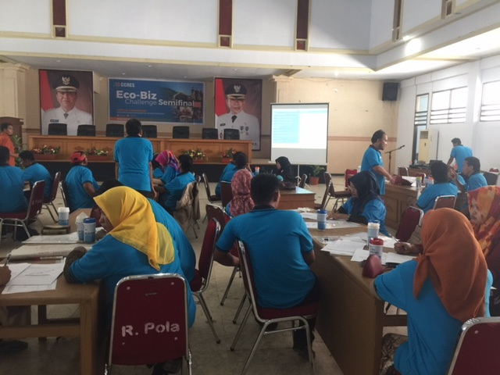
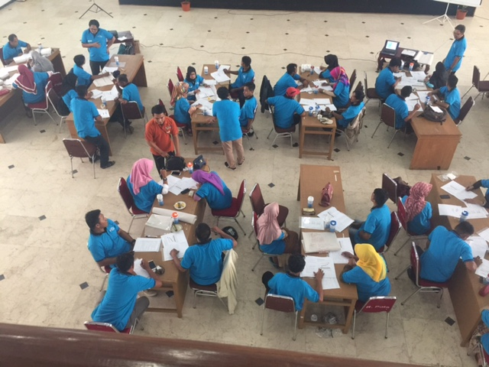
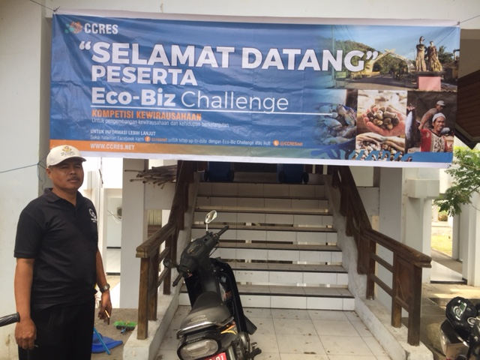
We have used the framework for local communities in Selayar as well as for researchers and scientists.

Slide 8
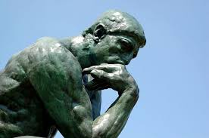
Questions that point to a pathway
What do I do with it?
Who will use it?
Is it commercially viable?
I discover something
Does that matter?
What’s next?
Do I protect it?
Do I expand on it?
How do I protect it?
How do I fund it?
Do I develop it?
What is the next generation?
How do I develop it?
How much will development cost?
Who else is doing it it?
Who will help me?
How long will it take?

Slide 9
Tourbillon animation
https://app.frame.io/presentations/23c87d74-8d78-4f39-8854-2648f8055478

Slide 10
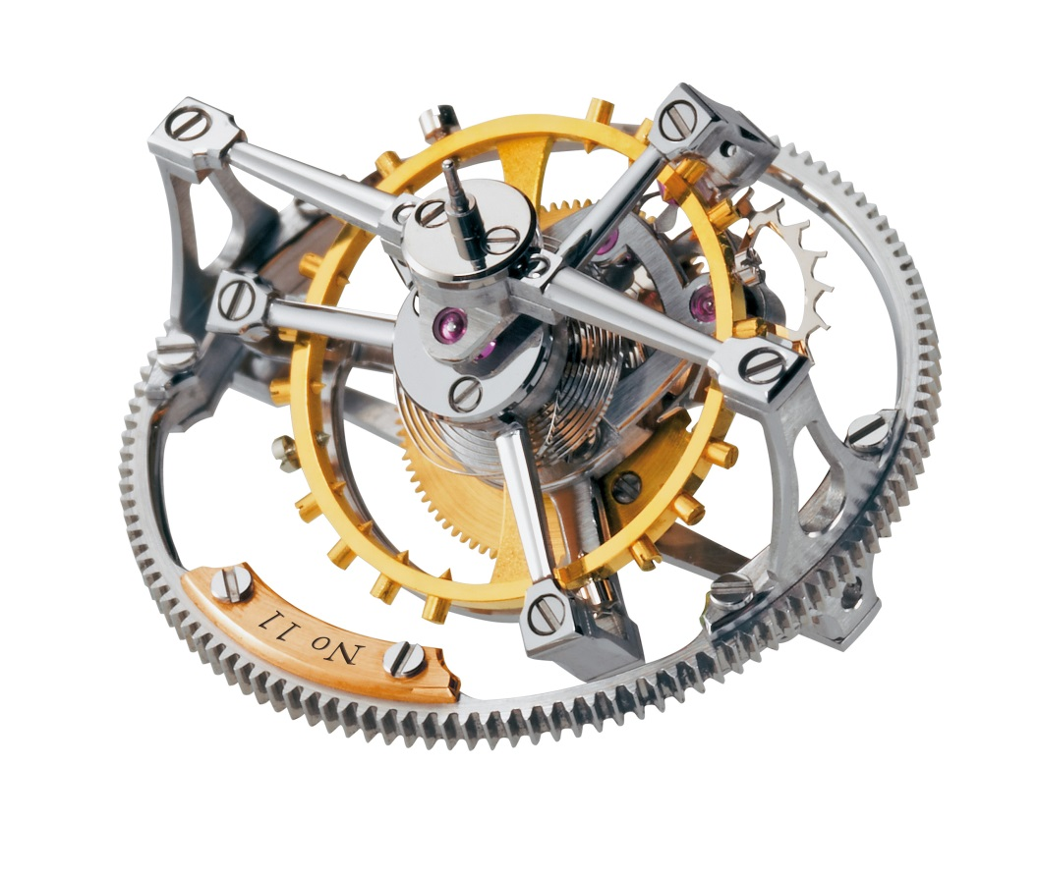
Tourbillon
Integration
Interrelationships
Decision point
Precision

Slide 12
Why use the Tourbillon?
It is a straightforward way of assessing the feasibility of an idea/technology.
It uses state of the art management tools.
It provides a systematic assessment.
It builds an evidence base for strong decisions.
It provides multiple choices at each step - so it allows the creative process to continue after you come up with idea.
It provides a cohesive strategy that provides confidence
It can save years of work pursuing a dream that has little likelihood of success.
It provides rapid business skills development.

Slide 14
We use a matrix to work out where a product or service sits
Rare?
High
Low
Private Goods
Collective Good
High
Excludable?
Common Goods
Public Goods
Low

Slide 15
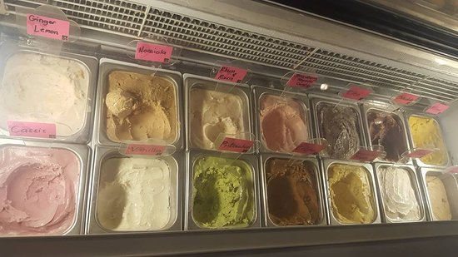
The two parts of the matrix
Rarity
- if one person's consumption of a good necessarily diminishes another person's consumption of it.
Excludable
if people (ordinarily, people who have not paid for it) can be prevented from using it.
A beach?
Low
High

Slide 16
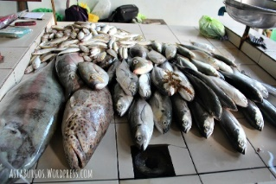
FOUR TYPES OF GOODS
Rare?
Where should these go:
Air?
Water?
Fish?
High
Low
Private Goods
Collective Good
High
Excludable?
Common Goods
Public Goods
Low

Slide 18
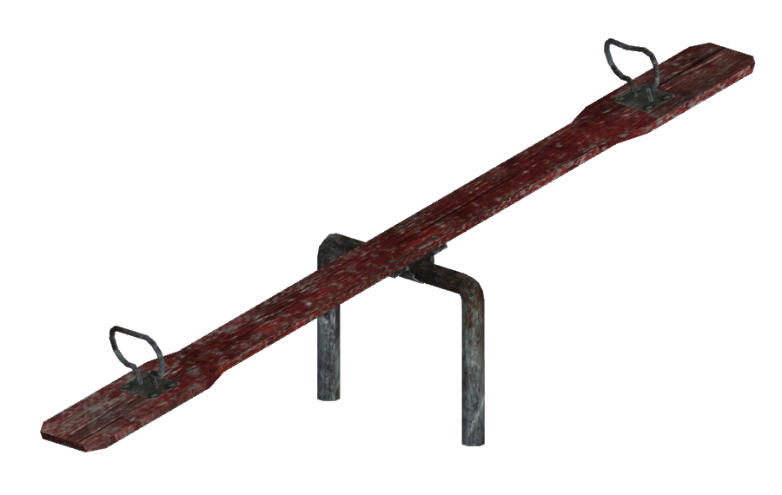
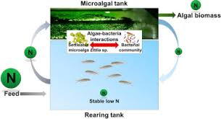
What type of value dominates?
Societal/ Environmental
Value
Commercial Value
Public Good
Private Good
Low excludability
High excludability
Low rivalry
High rivalry

Slide 19
Three ways to look at value
Social value
Environmental value
Economic value

Slide 20
Example
Make it expensive and only available to a few – but how will it help and who will buy it?
Make it reasonably priced and accessible – high sales and high benefit to environment.
Rival?
High
Low
1
High
Private Goods
Collective Good
2
Excludable?
Make it cheap and very easy to access for users – but how do you fund it?
3
Low
Common Goods
Public Goods

Slide 22
What is Intellectual Property?
“Intellectual property refers to creations of the mind: inventions, literary and artistic works, and symbols, names, images, and designs used in commerce.”
It is a productive new idea you create. This can be an invention, trade mark, design, brand or even the application of your idea

Slide 23
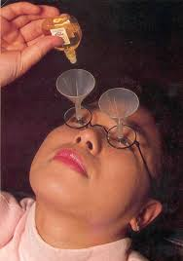
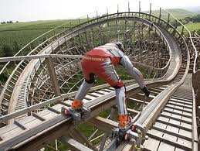
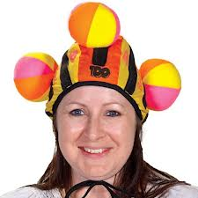
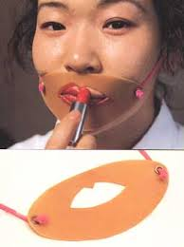
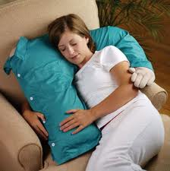
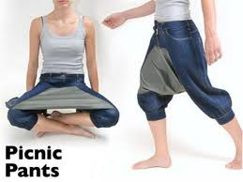
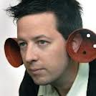
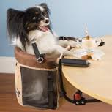
Ideas?
These are all patented

Slide 24
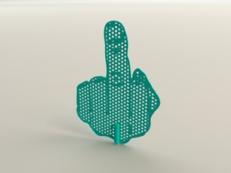
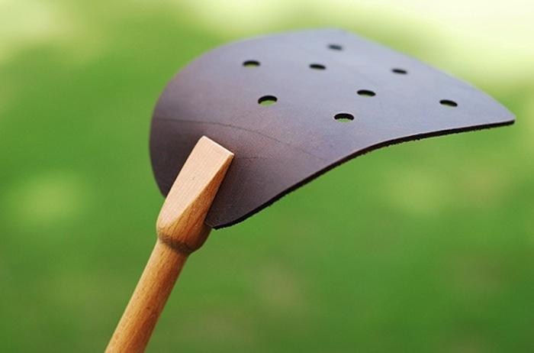
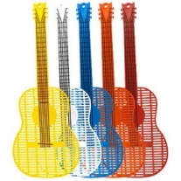
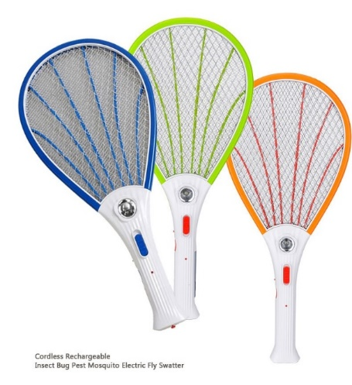
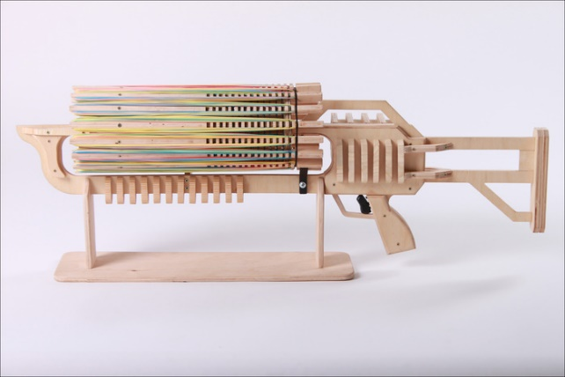
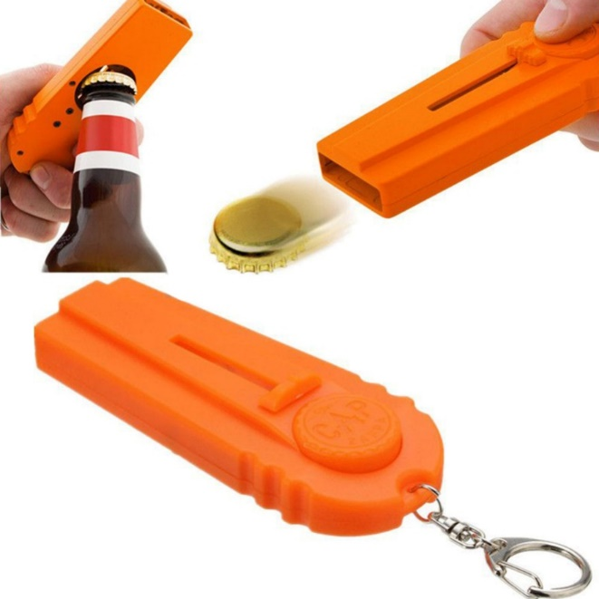
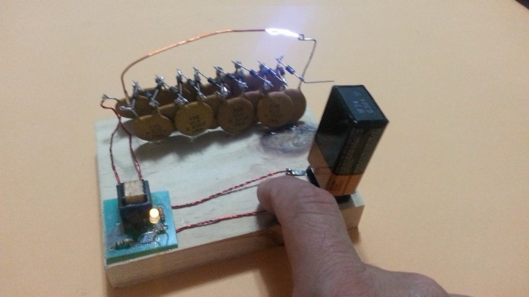
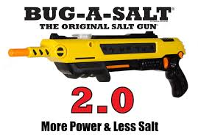
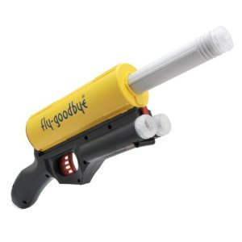
Any market you enter will be crowded.
Fly Swatters

Slide 25
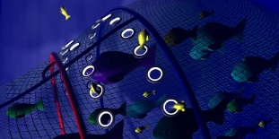
Types of intellectual property
Example: New generation fishing net
Patents
Method of manufacture
Trade Mark ®
The name
Designs
The shape
Plant Variety Rights
The hemp plant for the fibre
Copyright ©
Art on explanation and packaging
Trade Mark ™
The logo
Circuit Layouts
The electronics in the manufacturing equipment control
Trade Secret
The information used to design the net.

Slide 26
Ownership – some questions to ask yourself
Who actually owns the idea that is at the core of your product/service?
Where did it come from?
How did you develop it?
Do you need to give someone else the credit for the idea?
Should they be included in the protection?
What will happen if they are not included?

Slide 27
Acknowledging someone’s contribution
This can be done formally by sharing ownership, or simply giving credit to the person with the idea.
It can be done informally by talking to the person(s) who had the idea and making sure it is alright to proceed.
NEVER proceed with an idea when you know someone else has contributed without getting clearance from them first.

Slide 29
Ideas are great, but you need to do something with them to realise their value
Development cycles are all of the activities that need to occur to get your idea from your head to the market
Idea mapped
out
Evidence
the
idea works
Getting
ready to
sell to
customers
Final
prototype
Pipeline
Initial
idea
Market Launch

Slide 30
Activities and tasks at each stage
Idea mapped
out
Evidence
the
idea works
Getting
ready to
sell to
customers
Final
prototype
Pipeline
Initial
idea
Market Launch
In-house idea generation; collaborative discussions; internal collaboration; external collaboration
Experimentation; testing; exploring; creating; testing additional ideas;
Testing, testing, more testing, tweaking, trials and tribulations; field trials
Scale-up; Batch processing; bulk ordering; testing
Sourcing stock; equipment; compliance
Distribution, sales, negotiations, licensees, shop front, etc.
Notes:
Not just the broader activities, but within each broad area there are multiple activities that need to be performed
Also may not be a strictly linear process

Slide 31
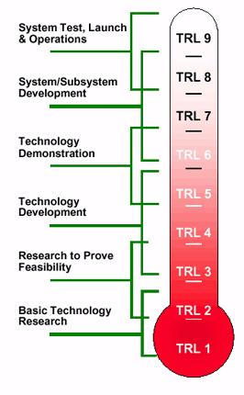
Technology readiness levels – Where are you? How long have you taken to get there?
How much further do you have to go?
Moving up through the
Technology Readiness Levels
9 Market launch
8 Final prototype
7 Getting ready to sell to customers
6 Showing potential customers it works
5 Testing your product/service in the field
4 Testing your product/service at home,
3 Evidence the idea works
2 Idea mapped out
1 Initial idea
You want to be here
How long will it take?
You are here

Slide 32
De-risking your technology
Value
$$
Risk
Initial
idea
Idea mapped
out
Evidence
the
idea works
Getting
ready to
sell to
customers
Final
prototype
Market Launch
Pipeline

Slide 33
Reducing your risk
Value
$$
You are here
?
?
You want to be here
Risk
?
Initial
idea
Idea mapped
out
Evidence
the
idea works
Getting
ready to
sell to
customers
Final
prototype
Market Launch
Pipeline

Slide 34
You are not alone
How do you propose to get there?
How long will it take?
Who else is on the same path?
Are they ahead of you or behind you?
What will kill your value?
Value
$$
Competitor
4
Competitor
1
Competitor
3
Competitor
2
Risk
You
Initial
idea
Idea mapped
out
Evidence
the
idea works
Getting
ready to
sell to
customers
Final
prototype
Market Launch
Pipeline

Slide 35
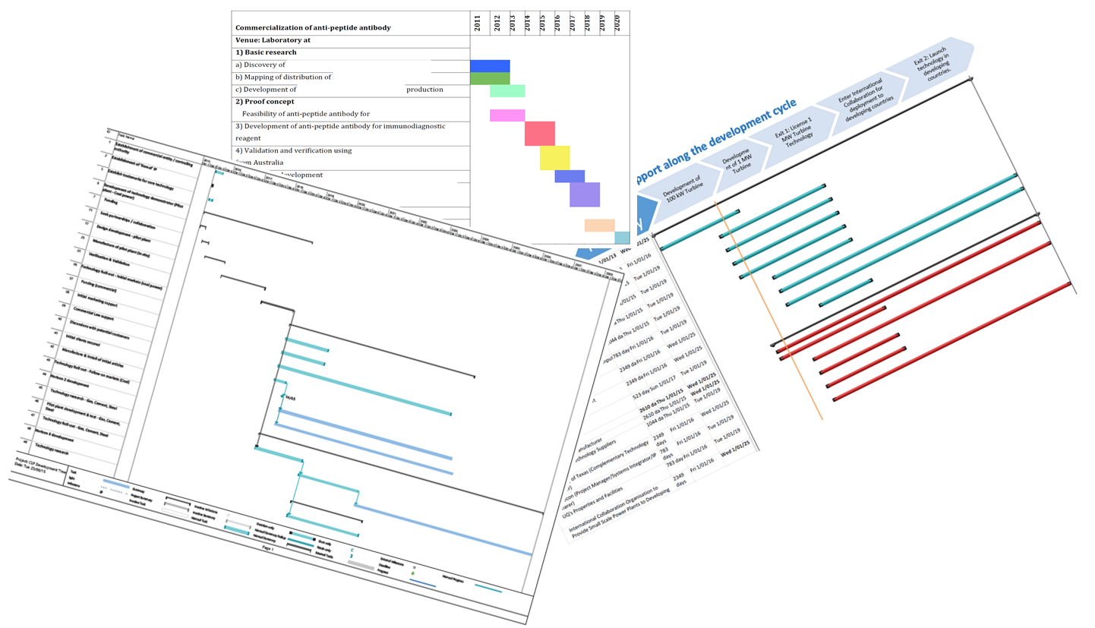
Realistic timelines
Development cycle – how long, how much, how hard, how complex

Slide 36
How long will each stage take?
?
?
?
?
?
?
Initial idea
Idea mapped out
Evidence the idea works
Getting ready to sell to customers
Final
prototype
Market Launch
How much will each stage cost?
?
?
?
?
?
?

Slide 38
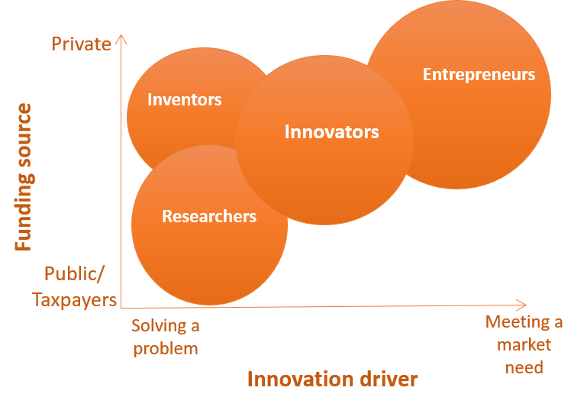
What is your skill set?
Are you an entrepreneur or a researcher? These are very different people.

Slide 39
The progression from science to business knowledge that follows the development cycle
Scientific knowledge
Business Knowledge
Discovery
Start-up
Product launch
Time
©Kastelle and Hine UQBS
Notes:
We need different types of knowledge as we move through the development cycle. The tasks become less science orientated and more business orientated.

Slide 40
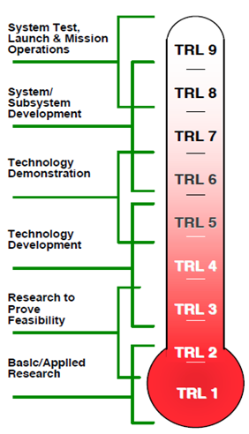
Why collaborate?
Different skills for different tasks.
Make better commercial viability judgements.
Access to more resources.
Increase development speed.
Effective search for competitor technologies.
Better knowledge of the market.
Access to industry partners.
Understand hurdles before you encounter them.
Increase your chances of commercial success.
Get me there

Slide 41
Innovation and commercialisation funding
Venture Capital
Funders
Government Agency
R&D Funding Agency
Idea mapped
out
Evidence
the
idea works
Getting
ready to
sell to
customers
Final
prototype
Pipeline
Initial
idea
Market Launch
Research Centre
Research
Core
Research Institute
Research Organisation
R&D Consortium
Research Facility
Adjunct Services
Commercialisation/Translational Organisation
Commercial Law
Management and Financial Consultancy

Slide 43
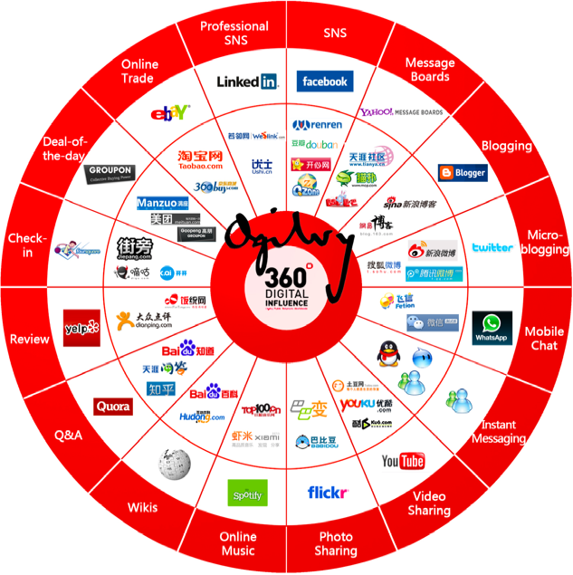
Find those innovators and
early adopters in their
market segments –
social media example
Source: http://www.thomascrampton.com/wp-content/uploads/china-social-media-equivalents.png

Slide 44
Different levels of your market
Macro Market – e.g. Global market for algal APIs
Middle Market –
e.g. National Market
Micro Market –
e.g. Queensland market

Slide 45
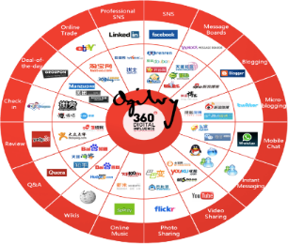
The tool(s): Markets and segments
Macro Market
Middle Market
Micro Market
Market segment 1
Market segment 2
Leading competitor
Other
competitors
Market
segment
8
Market
segment
3
Try and keep similar market segments together on the map.
Market
segment
7
Market
segment
4
Market segment
6
Market segment
5

Slide 47
The Killer Experiment
Research data that clearly proves the value of your technology compared to existing products or methods
Create the “million dollar slide”
Source: Joe McLean

Slide 48
Also helps identify potential collaborators
Is there a competitor with complimentary technology?
Is there a company in the middle market but not the micro market? They might want to license your technology to compete more effectively?
Is there a competitor with a large product range but not one in your area?

Slide 50
Pathways
How much risk are you prepared to take on
How important is keeping control of your idea
None
Some
A lot
Not
Some-
what
Very
Notes:
One of the core considerations when choosing a commercialisation pathway is determining which pathway best suits the characteristics of the product, process or service. However, another equally important consideration relates to the appetite of the controlling organisation for risk and its desire to retain control. Lets discuss these concepts and while we are doing so, think about where you think your company sits on the continuum.
Looking at the vertical axis first, lets consider commercialisation risk. At the lower end of the scale we have options such as outright sale or licensing of IP. These options shift the commercialisation risk (i.e. the risk that the commercialisation process may fail due to technical, market, financial or other problems) to the third party, leaving minimal residual risk with the licensor. This is an option often chosen by institutions that are risk averse and protective of their broader assets. At the other end of the scale are options like forming a start-up company. Where the institution that created the IP retains a large portion of the equity in the company, they also have a high risk exposure – should the company fail, and the value of this equity reduce, the creating institution will suffer heavy losses. There is also a heavy management load on the creating institution, which can draw scarce resources away from the institution’s core business.
Where does your institution fir on this axis? How do you think this will impact on decisions about which pathway to choose?
The horizontal axis describes the level of control the creating institution will retain for each of the commercialisation option. Again, at the lower end of the scale are outright sale and licensing. Generally, the licensee has a high level of control of the IP and how it is commercialised, and the creating institution is a relatively passive partner. This is one of the trade offs for shifting the risk across to the licensee. At the other end of the scale, options such as in-house production and start-ups allow the originating institution to continue to exert a high level of control – of course, the quid pro quo is there are high levels of cost and other resource required to do so.
Where does your institution sit on the “control” axis? Do you perceive it as important to retain a high level of control during the course of the commercialisation process?
Do the decisions made to date in relation to commercialisation within your institution reflect your assessment of appetite for risk and desire for control? If not, why do you think this is the case?

Slide 51
Pathways
Run it
yourself
A lot
Partnership
How much risk are you prepared to take on
Cooperative
Some
Hand over to
someone else
Abandon
None
Not
Somewhat
Very
How important is keeping control of your idea
Notes:
One of the core considerations when choosing a commercialisation pathway is determining which pathway best suits the characteristics of the product, process or service. However, another equally important consideration relates to the appetite of the controlling organisation for risk and its desire to retain control. Lets discuss these concepts and while we are doing so, think about where you think your company sits on the continuum.
Looking at the vertical axis first, lets consider commercialisation risk. At the lower end of the scale we have options such as outright sale or licensing of IP. These options shift the commercialisation risk (i.e. the risk that the commercialisation process may fail due to technical, market, financial or other problems) to the third party, leaving minimal residual risk with the licensor. This is an option often chosen by institutions that are risk averse and protective of their broader assets. At the other end of the scale are options like forming a start-up company. Where the institution that created the IP retains a large portion of the equity in the company, they also have a high risk exposure – should the company fail, and the value of this equity reduce, the creating institution will suffer heavy losses. There is also a heavy management load on the creating institution, which can draw scarce resources away from the institution’s core business.
Where does your institution fir on this axis? How do you think this will impact on decisions about which pathway to choose?
The horizontal axis describes the level of control the creating institution will retain for each of the commercialisation option. Again, at the lower end of the scale are outright sale and licensing. Generally, the licensee has a high level of control of the IP and how it is commercialised, and the creating institution is a relatively passive partner. This is one of the trade offs for shifting the risk across to the licensee. At the other end of the scale, options such as in-house production and start-ups allow the originating institution to continue to exert a high level of control – of course, the quid pro quo is there are high levels of cost and other resource required to do so.
Where does your institution sit on the “control” axis? Do you perceive it as important to retain a high level of control during the course of the commercialisation process?
Do the decisions made to date in relation to commercialisation within your institution reflect your assessment of appetite for risk and desire for control? If not, why do you think this is the case?

Slide 52
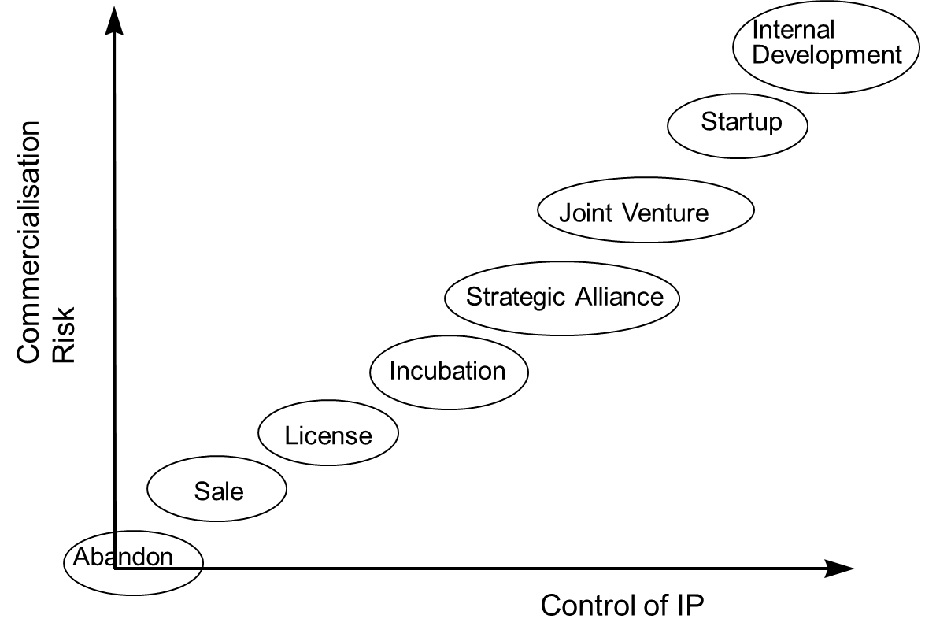
Pathways to markets
Stepping Stone
Source: John Kapeleris, 2012.

Slide 54
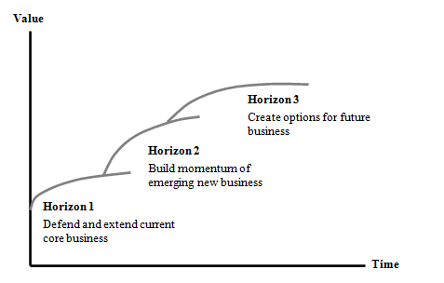
The Three Horizons Model –
planning your technology trajectory
Horizon 3
Third generation - What will disrupt you in the future – get ready now
Horizon 2
Second generation product/service– build the momentum
Horizon 1
Defend and extend current technology

Slide 56
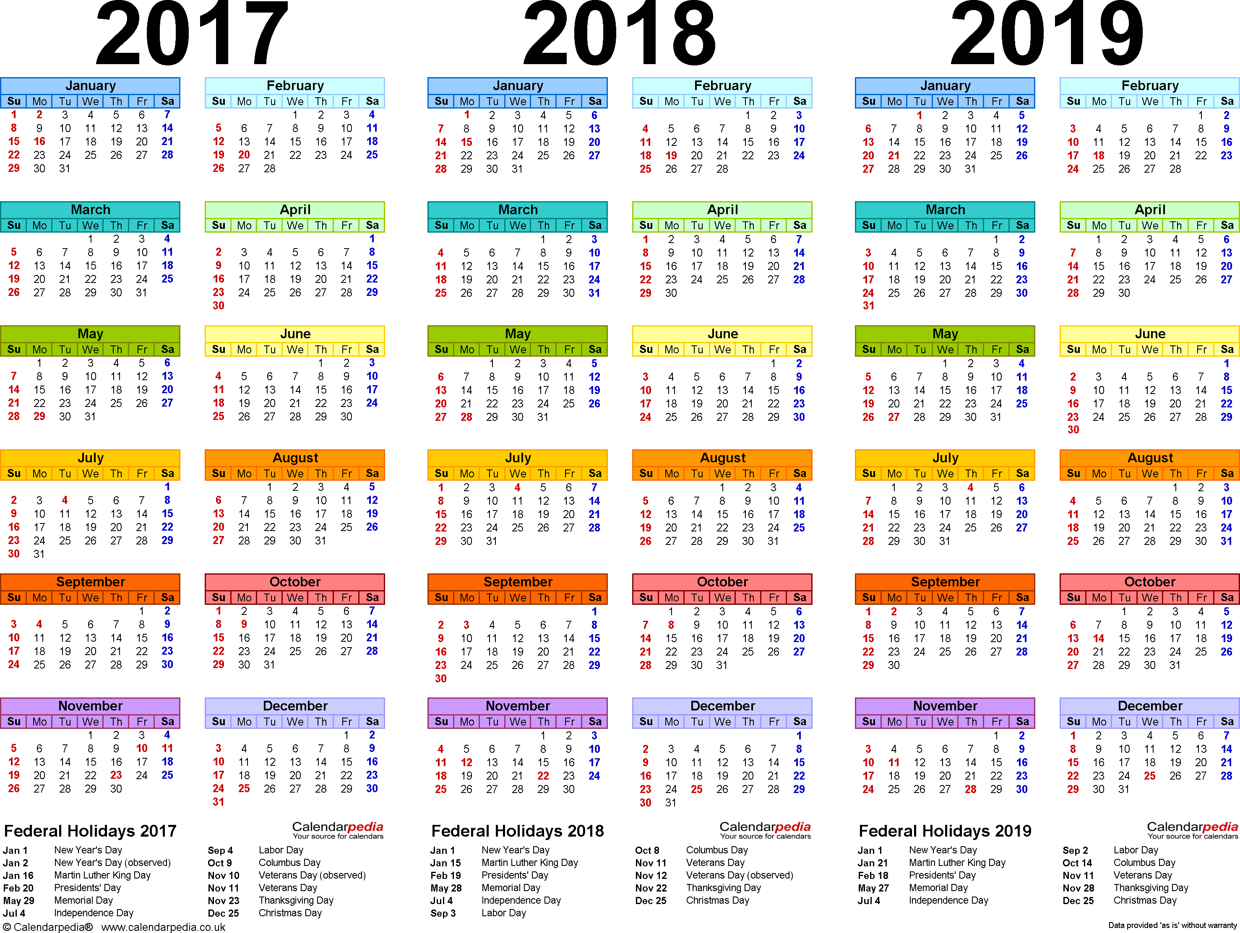
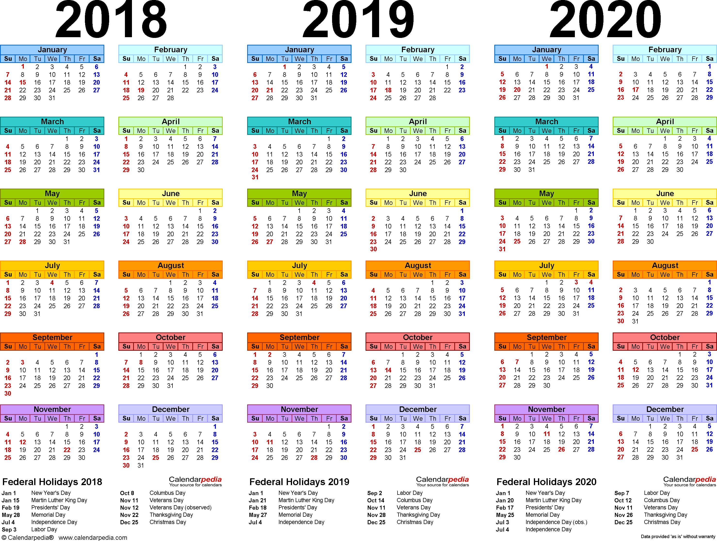
Match the horizons to your timeline.

Slide 58
Why do financials come last?
Understanding and being able to compile and confidently present the financials for a new idea/product/service is absolutely critical to its success. However financials should be a reflection of everything else in the feasibility assessment. That means every statement and decision in every step should be discernible in the financial statements.
So it is the glue that binds all the other steps, and essential for validating and cross-referencing everything across the feasibility assessment.

Slide 59
Profit and Loss for XYZ business
1st July 2018 - 30th June 2019
 | 2018-2019
Total Revenue/Sales | 100,000
Cost of Goods Sold
Direct materials | 10,000
Direct labour | 15,000
Manufacturing overhead | 3,000
Indirect labour | 2,000
Other manufacturing overheads | 0
Net Cost of Goods Sold | 30,000
Gross Profit | 70,000
Operating Expenses
Research and Development | 20,000
Selling, general and administrative | 30,000
Total Operating Expenses | 50,000
Operating Income or Loss | 20,000
Income from Continuing Operations
Interest expense | 30,000
Income tax expense | 2,000
Net Income from Continuing Operations | (12,000)
Non-recurring events | 1,000
Discontinued operations | 1,000
Extraordinary items
Net Income | (14,000)

Slide 60
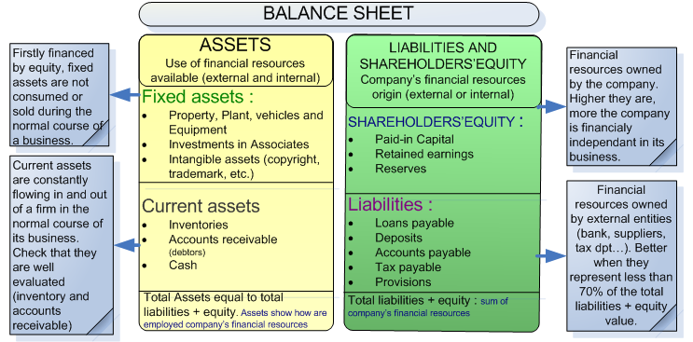
Parts of the Balance Sheet
Source: http://onlineaccountreading.blogspot.com.au/2014/06/balance-sheet.html#.WK-pnPl94UE

Slide 61
Balance Sheet for XYZ business
30th June 2019
 | $ | $
ASSETS
Non-current assets |  | 2,150,000
Land and buildings | 2,000,000
Furniture | 12,000
Machinery | 18,000
Investments | 120,000
Current assets |  | 10,000
Inventory | 1,000
Debtors/receivables | 3,200
Cash at bank | 5,800
 |  | 2,160,000
TOTAL ASSETS
OWNER’S EQUITY AND LIABILITIES
Owner’s equity |  | 1,700,000
Capital | 1,700,000
Non-current liabilities |  | 440,000
10% Loan | 440,000
Current Liabilities |  | 20,000
Creditors/payables | 20,000
TOTAL EQUITY AND LIABILITIES |  | 2,160,000

Slide 62
Matching horizons to sales and product life cycles. An example.
 | 2018-2019 | 2019-2020 | 2020-2021 | 2021-2022
Product One
Price | 10,000 | 10,000 | 8,000 | 7,000
Unit sales | 20 | 40 | 50 | 40
Market share | 1% | 1.5% | 1.5% | 1.5%
Product Two
Price |  | 12,000 | 12,000 | 10,000
Unit sales |  | 40 | 80 | 100
Market share |  | 2% | 3.5% | 5%
Product Three
Price |  |  |  | 5,000
Unit sales |  |  |  | 200
Market share |  |  |  | 2%
Total Sales | 200,000 | 880,000 | 1,360,000 | 2,280,000
Product one comes on stream, with sales building and then falling away as it gains some traction in the market and funds the Horizon 2 product. P2 leverages the success of P1 by building scale and revenues faster. P3 may utilise new technology for lower cost, higher scale production and generate rapid revenues to offset the decline from P1. So the business builds across products and generations.

Slide 63
Matching horizons to sales and product life cycles An example:
 | 2018-2019 | 2019-2020 | 2020-2021 | 2021-2022
Product One
Price | 10,000 | 10,000 | 8,000 | 7,000
Unit sales | 20 | 40 | 50 | 40
Market share | 1% | 1.5% | 1.5% | 1.5%
Product Two
Price |  | 12,000 | 12,000 | 10,000
Unit sales |  | 40 | 80 | 100
Market share |  | 2% | 3.5% | 5%
Product Three
Price |  |  |  | 5,000
Unit sales |  |  |  | 200
Market share |  |  |  | 2%
Total Sales | 200,000 | 880,000 | 1,360,000 | 2,280,000
Notes:
Product one comes on stream, with sales building and then falling away as it gains some traction in the market and funds the horizon 2 product. P2 leverages the success of P1 by building scale and revenues faster. P3 may utilise new technology for lower cost, higher scale production and generate rapid revenues to offset the decline from P1. So the business builds across products and generations. This looks like a short development cycle, cash flow based business. Optimistic, but not unheard of.

Slide 64
Exercise: Icons from all steps

Slide 65
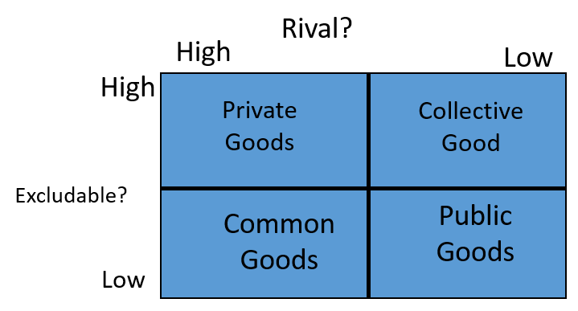
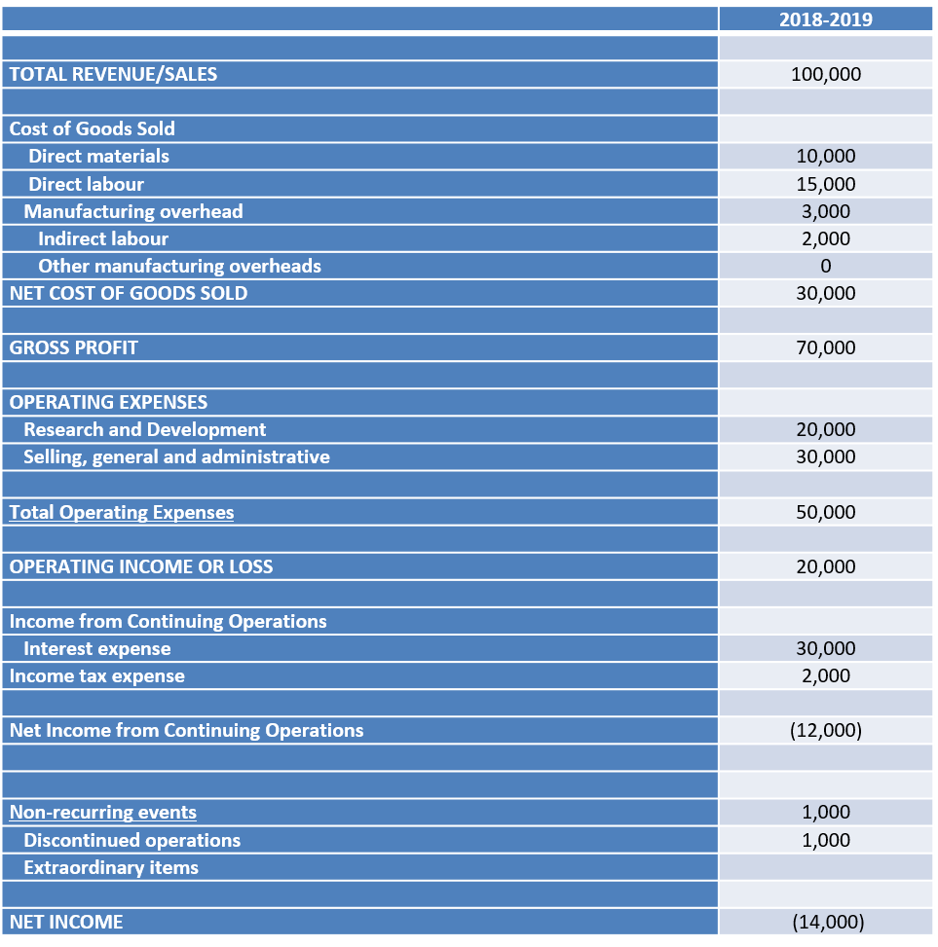
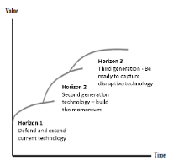
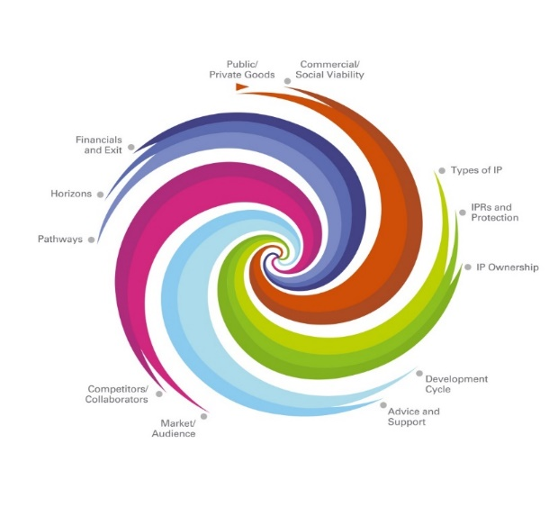
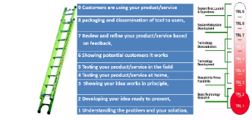
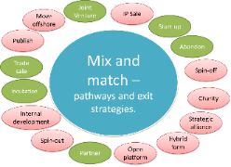
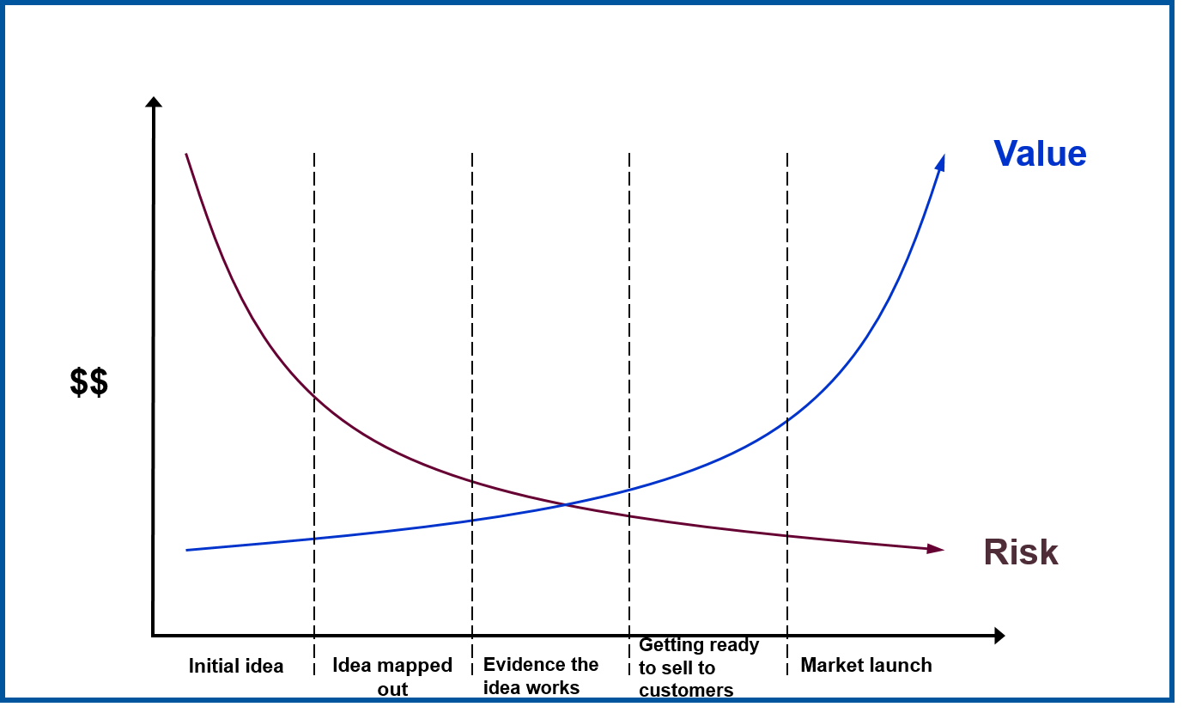
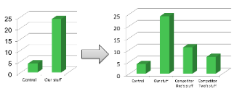
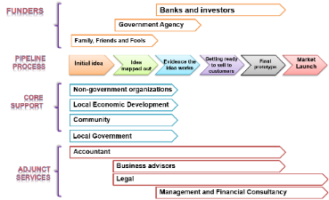
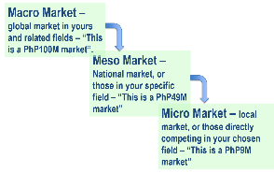
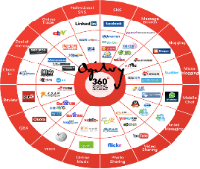
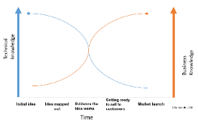

Slide 66
Summary video
https://app.frame.io/presentations/2d648a02-b16a-40c2-be0a-bea6d0871c7a

Slide 67
EcoBiz Process
The top 25% of the applications selected as semi-finalists and invited to participate in a 3 day Business Workshop
The semi-finalists submitted a formal business proposal. The final winners received a one-time equity grant of IDR 15,000,000 to start or expand their business idea

Slide 68
Thank you
Any questions?

