Slide 1
Economic Empowerment in Digital Economy Era
Choi Won Gyu, Ph.D., Professor, Chonbuk National University, Republic of Korea
President, Korea Academy of Social Welfare

Slide 2
What is Digital Economy Era?
The Fourth Industrial Revolution builds on the Digital Revolution, representing new ways in which technology becomes embedded within societies and even the human body.
The Fourth Industrial Revolution is marked by emerging technology breakthroughs in a number of fields, including robotics, artificial intelligence, nanotechnology, quantum computing, biotechnology, The Internet of Things (IoT), 3D printing and autonomous vehicles.
The Fourth Industrial Revolution by Klaus Schwab “Mastering the Fourth Industrial Revolution” was the theme of the World Economic Forum Annual Meeting 2016 in Davos-Klosters, Switzerland.
"What is the fourth industrial revolution?". World Economic Forum. Retrieved 2016-12-12.

Slide 3
The Fourth Industrial Revolution?
One of skeptic scholars about the 4th Industrial Revolution, Robert J. Gordon(1940~), predicts a dark future of “epochal decline in growth from the U.S. record of the last 150 years.” The greatest innovations, Gordon argues, are behind us, with little prospect for transformative change along the lines of the three previous industrial revolutions.
Thomas B. Edsall(2012), “No More Industrial Revolutions?”
(https://campaignstops.blogs.nytimes.com/2012/10/15/no-more-industrial-revolutions/)

Slide 5
To understand the 4th IR, we look closely at the 1st IR, the 2nd IR and the 3rd IR
the 1st Industrial Revolution from 1750 to 1830, steam engine, railroads, knitting machine, machines for draining water from coal mines etc. mechanical revolution, saving hard work.
the 2nd Industrial Revolution from 1870 to 1900, electricity, internal combustion engine, running water, indoor toilets, communications, entertainment, chemicals, petroleum. mass society(Karl Mannheim), Fordism, Taylorim

Slide 6
To understand the 4th IR, we look closely at the 1st IR, the 2nd IR and the 3rd IR
the 3rd Industrial Revolution, from 1960 to 1980, computers, and internet.
Information Revolution
Alvin Toffler(1980), The Third Wave, ISBN 0-517-32719-8

Slide 7
the 4th Industrial Revolution
characterized by a fusion of technologies that is blurring the lines between the physical, digital, and biological spheres.
It is marked by emerging technology breakthroughs in a number of fields, including robotics, artificial intelligence, blockchain, nanotechnology, quantum computing, biotechnology, The Internet of Things, The Industrial Internet of Things (IIoT), fifth-generation wireless technologies (5G), additive manufacturing/3D printing and fully autonomous vehicles.
Source) https://en.wikipedia.org/wiki/Fourth_Industrial_Revolution

Slide 8
smart factory EWA(Electronics Works Amberg), Deutchland
The End of Defects: defect rate 0.0011%, Productivity Increases 4,000%, connected all machines by software with sensor in each machine.
Aggregating big data, 5 millions of data per day. Automatic switch off when certain machines idle.
Based on the amalgamation of Manufacture and ICT(Information and Communication Technology)

Slide 9
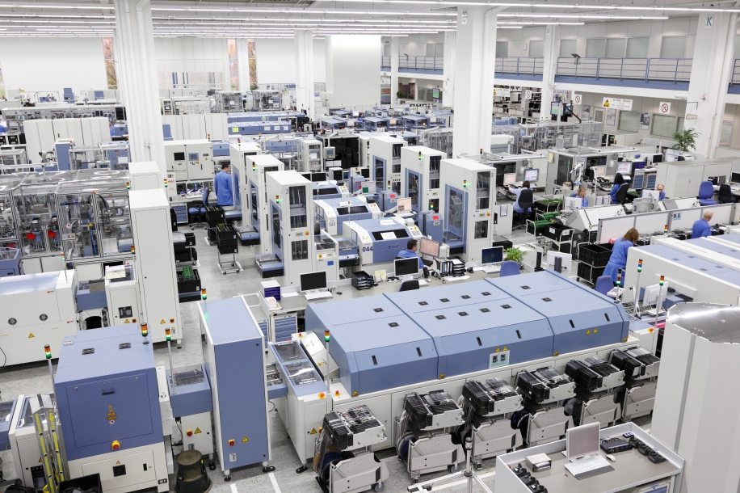

Slide 10
Connected Car Advertisement by Hyundai Automotive
Smart Car with ICT: traffic information, real time navigation, remote check on car, multimedia streaming etc.
Many experts and professionals such as meteorologists, voice analysists, health care experts, city life analysists, experts in IoT(Internet of Things), researchers on social media etc. work together at the automotive plant.

Slide 11
Hyundai Blue Link and Smartcar Team Up to Build an Expanded Infrastructure for the Connected Car

Slide 12
What is IoT: Internet of Things
The Internet of Things (IoT) is the network of physical objects—devices, vehicles, buildings and other items embedded with electronics, software, sensors, and network connectivity—that enables these objects to collect and exchange data.
Source) The Internet of Things (IoT) - UT Dallas
https://www.utdallas.edu/.../files/IoT-by-UT-Dallas-022416.pptx

Slide 13
Internet of Things

Slide 14
Which Country will survive and advance in the 4th Industrial Revolution Era?
1. Countries which have Strong Manufacture Bases will survive and advance in the 4th Industrial Revolution Era.
The core of the 4th Industrial Revolution is the combination of ICT and Manufacture. Manufacture is the base on which ICT could blossoms. APPLE, SAMSUNG and HAIER are based on strong manufacture.

Slide 15
Which Country will survive and advance in the 4th Industrial Revolution Era?
2. Countries which have Big Data will survive and advance in the 4th Industrial Revolution Era.
The problem is that there will be more gaps in the big data approach between countries, between regions, between urban and rural areas, and between the rich and the poor.

Slide 16
Which Country will survive and advance in the 4th Industrial Revolution Era?
3. Metropolitan Area for smart city
smart city: Citizens' Quality of Life could be upgraded in a city that can solve problems such as traffic, environment, housing, health, water, education, medical care, and rescue by ICT and IoT.
① big population size
② high density of population
③ high income level of residents
Tokyo, Seoul, New York, Beijing could become smart cities.

Slide 17
Which Country will survive and advance in the 4th Industrial Revolution Era?
4. Democratic government to achieve social integration
Red Flag Act of 1865, England
When the car first appeared, the wardens were afraid of losing their jobs, and as a rule they passed unanimously the Red Flag Act
When driving a car, then a person had to stand in front of the car carrying red flag.
At that time, the provisions of the law included the following;
① Three drivers are required for one car.
② One of the drivers keeps the speed of the car while walking in front of the car with a red flag (red candle at night) and predicts the approach of the wagon or passers-by.
③ The maximum speed of the car was limited to 6.4 km / h and 3.2 km / h in the city center.
④ You must pay the road tax when you move to another city.
This led to the handing over of the automotive industry to Germany, despite Britain developing the car first. We need a powerful government that can integrate social minorities such as wardens in a democratic manner.

Slide 19
Big Data : Technology to read Human Mind
Big Data is not collecting a large amount of data, but by reading the mind of human beings, it predicts the intention of human action and it changes the behavior of human beings.
Example) PARO is an advanced interactive robot developed by AIST, a leading Japanese industrial automation pioneer. It allows the documented benefits of animal therapy to be administered to patients in environments such as hospitals and extended care facilities where live animals present treatment or logistical difficulties.
By interaction with people, PARO responds as if it is alive, moving its head and legs, making sounds, and showing your preferred behavior. PARO also imitates the voice of a real baby harp seal.

Slide 20
VR vs AR
VR(Virtual Reality) is an interactive computer-generated experience taking place within a simulated environment, that incorporates mainly auditory and visual, but also other types of sensory feedback like haptic. This immersive environment can be similar to the real world or it can be fantastical, creating an experience that is not possible in ordinary physical reality.
AR(Augmented Reality) is an interactive experience of a real-world environment whereby the objects that reside in the real-world are "augmented" by computer-generated perceptual information, sometimes across multiple sensory modalities, including visual, auditory, haptic, somatosensory, and olfactory. The overlaid sensory information can be constructive (i.e. additive to the natural environment) or destructive (i.e. masking of the natural environment) and is seamlessly interwoven with the physical world such that it is perceived as an immersive aspect of the real environment.
Source) https://en.wikipedia.org/wiki/Virtual_reality
https://en.wikipedia.org/wiki/Augmented_reality

Slide 21
VR(Virtual Reality)

Slide 22
AR(Augmented Reality) : Pocket mon go

Slide 23
Post Modern style of Production
From mass production of small kinds to small production of mass kinds
Decentralization, de-enlightenment, postmodernism
Refusing uniform consumption. Orienting towards individualized and customized consumption
Haier : customers could watch the whole process of his or her order such as washing machines.
Harley- Davidson : a style of customization

Slide 24
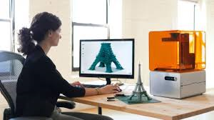
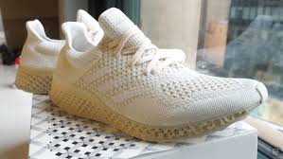
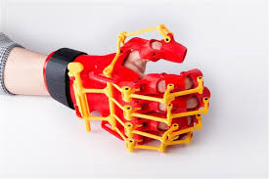
3D Printing
3D printing is any of various processes in which material is joined or solidified under computer control to create a three-dimensional object, with material being added together (such as liquid molecules or powder grains being fused together).

Slide 25
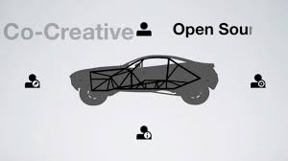
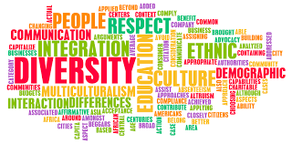
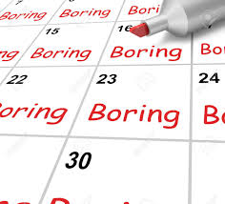
Businesses which survive and win have
① based on the demand.
ex) Local Motors is an American motor vehicle manufacturing company focused on low-volume manufacturing of open-source motor vehicle designs using multiple microfactories. The company develops vehicles using 3D Printing and utilizes vehicle designs provided by the online community
② Diversity in Workforce which enables Creativity in business.

Slide 26
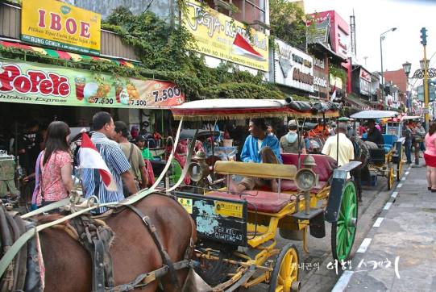
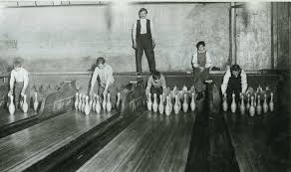
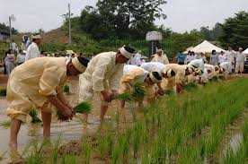
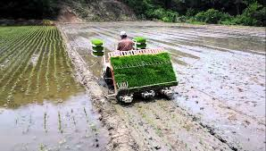
the 4th Industrial Revolution and Unemployment
Past examples) Typesetting machine – Typesetter Lost jobs Cars - Wagon workers lost their jobs (?) Pin bowling - Pin setter lost job Refrigerator - Milk Delivery Job Lost Water supply - Plumbing Job Reduced dial telephone - telephone exchange job lost Rice plantation machine - farmer's job lost

Slide 27
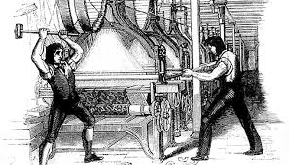
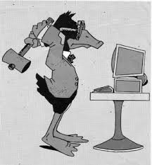
Solutions for Unemployment in the 4th IR
Luddite(1811-1812)? No!
Then what were the solutions for unemployments?
①Job Sharing: Prohibition on Child Labor, 8 Hours Work, etc
②Service Jobs
③Unemployment Insurance: 1905 France, 1911 England etc.
New initiatives for the new unemployment in the 4th IR Era
④Basic Income : A basic income, also called basic income guarantee, universal basic income(UBI), basic living stipend(BLS), or universal demogrant, is a type of program in which citizens (or permanent residents) of a country may receive a regular sum of money from a source such as the government.
⑤Robot tax : South Korea has introduced what is being called the world's first tax on robots amid fears that machines will replace human workers, leading to mass unemployment.
Source) https://www.telegraph.co.uk/technology/2017/08/09/south-korea-introduces-worlds-first-robot-tax/

Slide 28
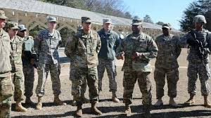
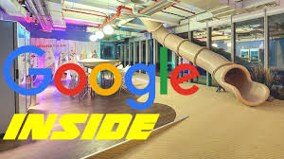
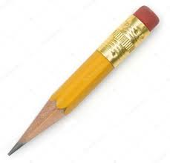
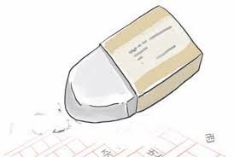
AI and Empowerment : How to cultivate Creativity
①Liberty based on individualism
②Positive Incentives
③Let's be unfamiliar: Through Journey and Studying(Reading) makes the familiar into unfamiliar
1564 1770 1858

Slide 29
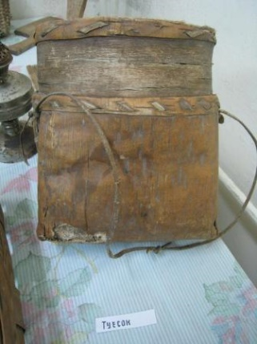
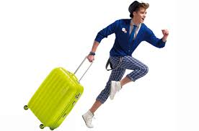
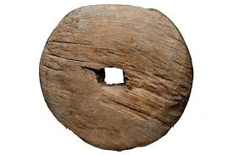
Creativity : Let’s be unfamiliar
More than 5,000 years ago, wheels and wooden boxes invented,
But Carriers with wheels invented less than one hundred years ago

Slide 30
references
Klaus Schwab(2016), “Mastering the Fourth Industrial Revolution” World Economic Forum Annual Meeting 2016 in Davos-Klosters, Switzerland.
World Economic Forum(2016), “What is the fourth industrial revolution?". Retrieved 2016-12-12.
Thomas B. Edsall(2012), “No More Industrial Revolutions?”(https://campaignstops.blogs.nytimes.com/2012/10/15/no-more-industrial-revolutions/)
Alvin Toffler(1980), The Third Wave, ISBN 0-517-32719-8
https://en.wikipedia.org/wiki/Fourth_Industrial_Revolution
The Internet of Things (IoT) - UT Dallas, https://www.utdallas.edu/.../files/IoT-by-UT-Dallas-022416.pptx, https://www.telegraph.co.uk/technology/2017/08/09/south-korea-introduces-worlds-first-robot-tax/
https://en.wikipedia.org/wiki/Virtual_reality
https://en.wikipedia.org/wiki/Augmented_reality
The Internet of Things (IoT) - UT Dallas
https://www.utdallas.edu/.../files/IoT-by-UT-Dallas-022416.pptx
https://en.wikipedia.org/wiki/Fourth_Industrial_Revolution
Choi Jinki(2018), “the 4th Revolution summarized in a book”, The Easy Publishing.

