Slide 1
Selecting
Peer Reviewed Journals
Submission and Review Process

Slide 2
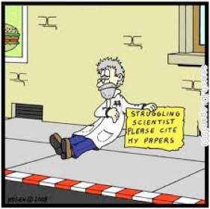
OUT LINE
The road to publication
Selecting the proper Journal
Submission and Reviewe Process

Slide 3
The Road to Publication
1. Manage
submissions
5. Publish & Disseminate
2. Manage Peer Review
PUBLISHER
DOING
RESEARCH
WRITING
ARTICLE
4. Production
3. Edit & prepare

Slide 4
What type of manuscript?
Full articles / Original articles:
the most important papers, significant completed pieces of research.
Letters / Rapid Communications/ Short communications: quick and early communication of significant and original advances. Much shorter than full articles (check limitations).
Review papers / perspectives: summarize recent developments on a specific topic. Highlight important previously reported points.
Self-evaluate your work. Is it sufficient for a full article? Or are your results so thrilling that they should be shown as soon as possible?
Ask your supervisor and your colleagues for advice on manuscript type.

Slide 5
1. Select the proper journal for submission
Search a Journal by Journal Finder.
Ask yourself the following questions:
Is the journal peer-reviewed?
Is the journal relevant?
Is the journal a prestigious journal?
Is the journal discoverable?
Is the journal open access?
Notes:
Some journal will publish no more than one article from the non-English speaking region or from the developing countries in one year. Avoid submitting to such journals unless you are really outstanding… ARNOUT: seriously? That sounds like unacceptable discrimination. Do you have any concrete examples?

Slide 6
1.1 Journal Finders
Scholarly Peer review is the process of subjecting an author's scholarly work, research, or ideas to the scrutiny of others who are experts in the same field, before a paper describing this work is published in a journal, conference proceedings or as a book.
Some Journal Finders :
Elsevier Journal finder
Manuscript matcher
Springer Nature Suggester

Slide 7
Elsevier Journal finder (Scopus)

Slide 8
Manuscript matcher (Thomson Reuters)

Slide 9
Springer Nature Suggester (Scopus)
Radial Variation in Selected Wood Properties of
Indonesian Merkusii Pine
ABSTRACT
Life Sciences

Slide 10
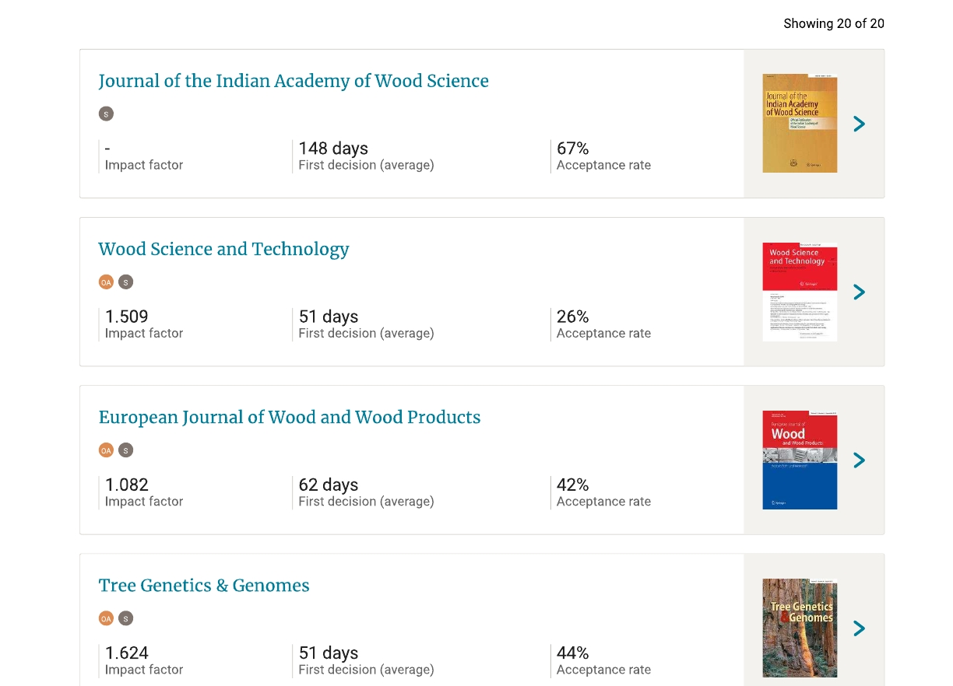

Slide 11
1.2 Is the journal peer-reviewed?
Ulrichsweb Global Serial Directory
(300,000 journal, 900 subject)
Open Ulrich's.
Open Ulrich's web
Type the JOURNAL TITLE into the search box, and click the green search button.
In the search results, look for a referee jersey icon to indicate that a journal is refereed, which is a synonym for peer-reviewed.
Or you can click on a journal to see the full record.

Slide 12
1.3 Is the journal relevant?
https://www.springer.com/life+sciences/forestry/journal/13196
Aims and Scope
The Journal aims to cover research on all aspects of Wood Science and allied fields relating to resource utilization of wood. In essence it relates to all aspects of utilization including processing, sales and marketing of wood, its products and other lignocellulosic materials both from forestry and agricultural origin.

Slide 13
1.4 Is the Journal a prestigious journal?
Check Journal Impact
1. Impact Factor (IF) Web of Science database
The impact factor (IF) is used to measure the importance or rank of a journal by calculating the times it's articles are cited.
Calculation of 2017 IF of a journal:
A = the number of times articles published in 2015 and 2016 were cited by indexed journals during 2017 (example : 500 times)
B = the total number of "citable items" published in 2015 and 2016.
(2015 = 120 articles, 2016 = 120 articles)
2017 impact factor = A/B = 500/240 = 2.08

Slide 14
2. SCImago Journal Rank (SJR) SCOPUS data based
https://www.scimagojr.com/
Journal of Indian Academy of Wood Science

Slide 15
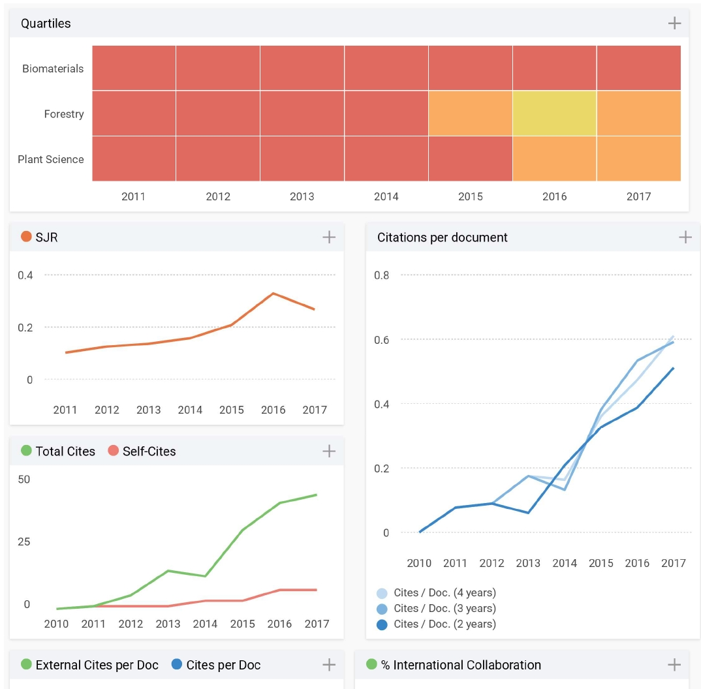
Quartile Q3
H index 5
h index of 20 is good, 40 is outstanding, and 60 is truly exceptional.
The advantage of the h-index is that it combines productivity (i.e., number of papers produced) and impact (number of citations) in a single number.

Slide 16
The Importance of the Rank in DIKTI
Jurnal International Bereputasi :
Scopus indexed SJR with Q1, Q2, Q3, Q4
Web of Science with an IF
Special Term/Requirement for Prof submission
Jurnal Internasional
Scopus indexed but without SJR
Web of Science without IF

Slide 17
1.5 Is the Journal discoverable?
A journal is more likely to be discovered if it is indexed by a major journal database providing easy access to content to researchers.
To make our article more discoverable:
Provide keywords when submit article the Journal
Register to Google Scholar and or Scopus
Use personal webpage
Use your ORCiD identifier

Slide 18
1.6 Is the Journal open access?
Good starting place to search for open access journal
The Directory of Open Access Journals (DOAJ)
https://doaj.org/
2. The Directory of Open Access Scholarly (ROAD)
http://road.issn.org/
Open database of the Journal
Search the content

Slide 19
https://doaj.org/

Slide 20
OPEN ACCESS

Slide 21
Support Open Access

Slide 22
Support Open Access

Slide 23
Decide on one journal.
DO NOT submit to
multiple journals.
Ethics in Science and Publication

Slide 24
Submission
And
Review Process
for a peer reviewed journal

Slide 25
1. Publication Process

Slide 26
2. Prepare documents for Submition
COVER LETTER
SUGGEST POTENTIAL REVIEWERS
ARTICLE FILES:
Abstract
Main Text
Figure
Table

Slide 27
2.1 Cover Letter
Promotion : you want to “sell” your work
Why did you submit the manuscript to THIS journal?
Mention what would make your manuscript special to the journal
Mention special requirements
you do not wish your manuscript to be reviewed by certain reviewers, conflicts of interest.
a good cover letter may accelerate the editorial process of your paper.

Slide 28
2.2 Suggest Reviewer
To help the Editor to move your manuscript to the review stage more efficiently.
Find potential reviewers and their contact details from articles in your references
At least two regions of the world, should not be your supervisor or close friends.
Be prepared 3-6 potential reviewers.

Slide 29
3. Start Submission
Journal on Springerl ink
Online First Articles
All Volumes & Issues
For authors and editors
Aims and Scope
Submit Online
Instructions for Authors
Copyright Transfer Statement (pdf, 97 kB...
Author Academy: Training for Authors
English Language Editing
Copyright Information
Services for the Journal
Contacts
Download Product Flayer
Choose this Menu
International Bereputasi
Terindex Scopus,
SJR Q3

Slide 30
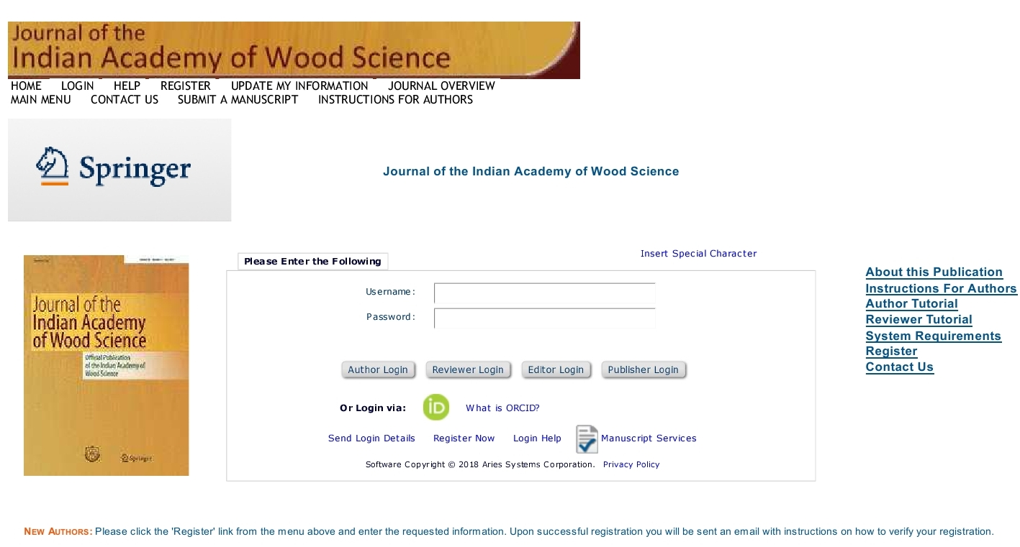
3.1 Login Menu

Slide 31
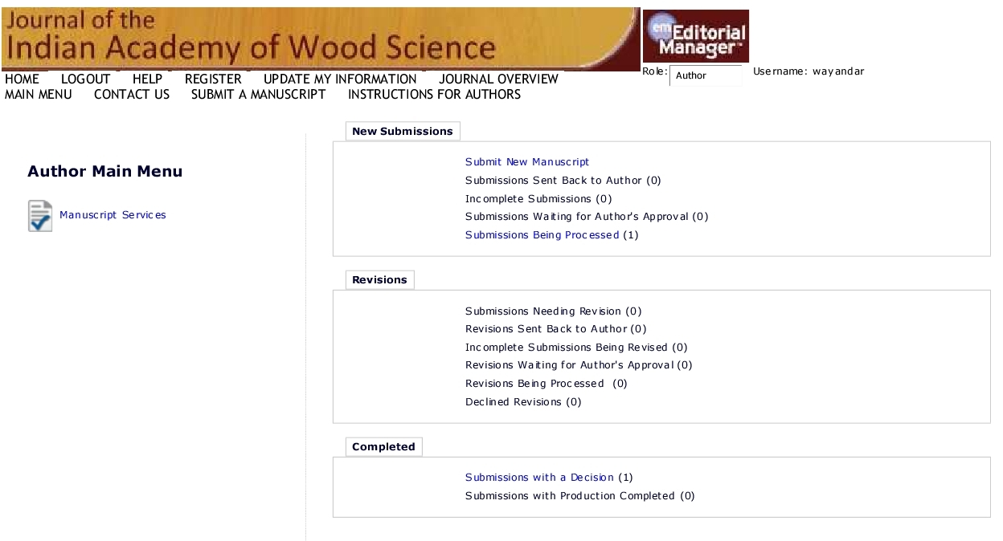
3.2 Author Menu
Choose this Menu
For new submit

Slide 32
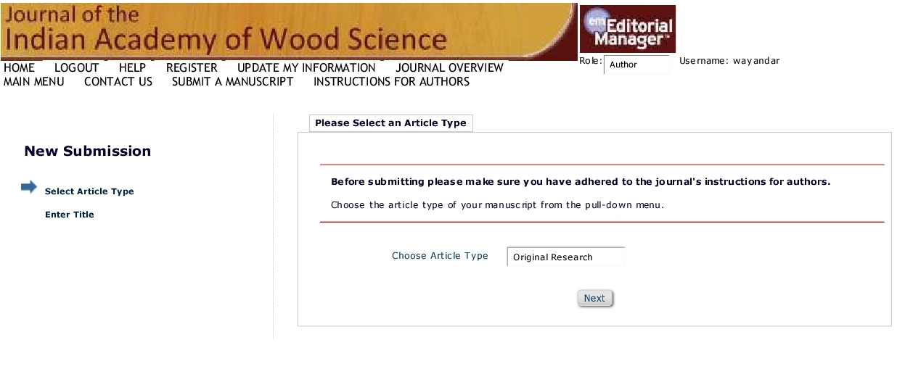

Slide 33
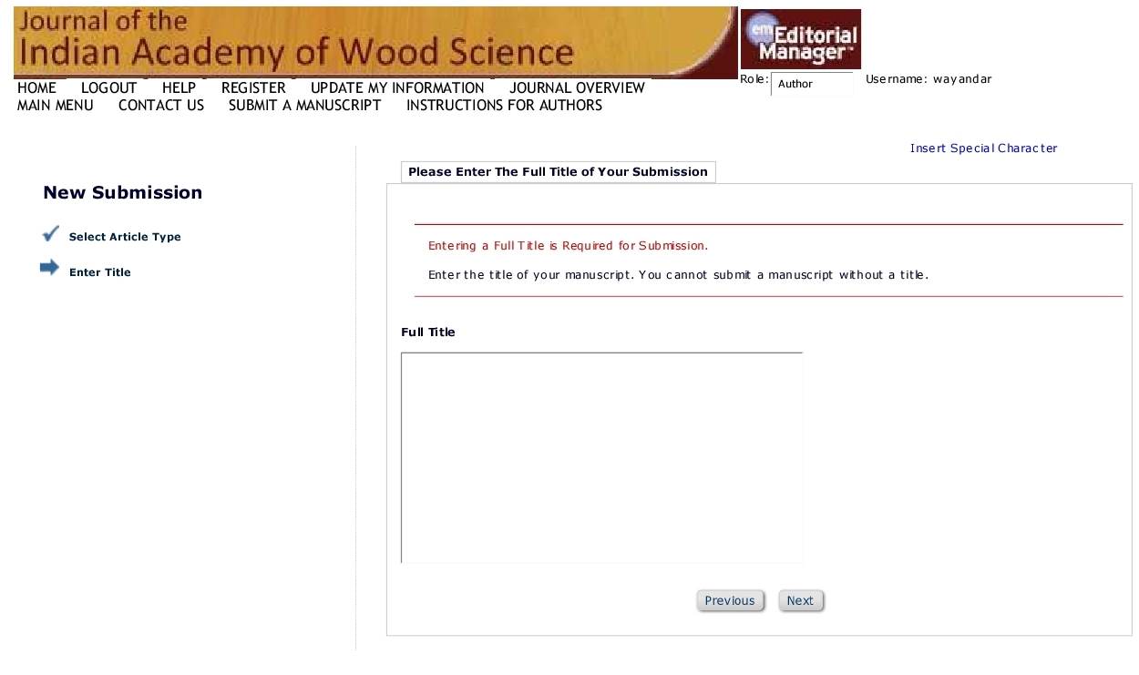
The chips generated during up milling and down milling of pine wood by helical router-bits

Slide 34
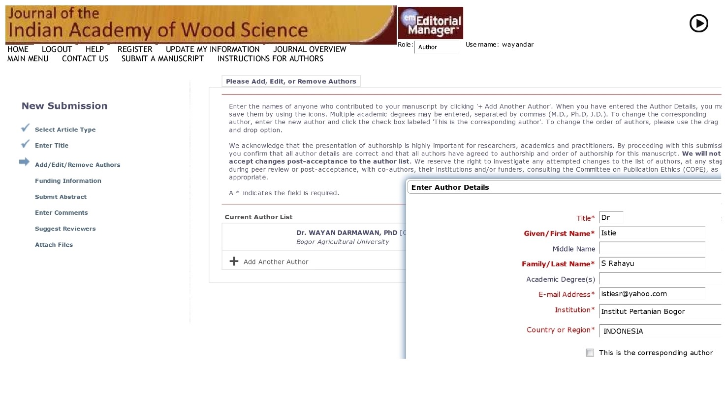

Slide 35
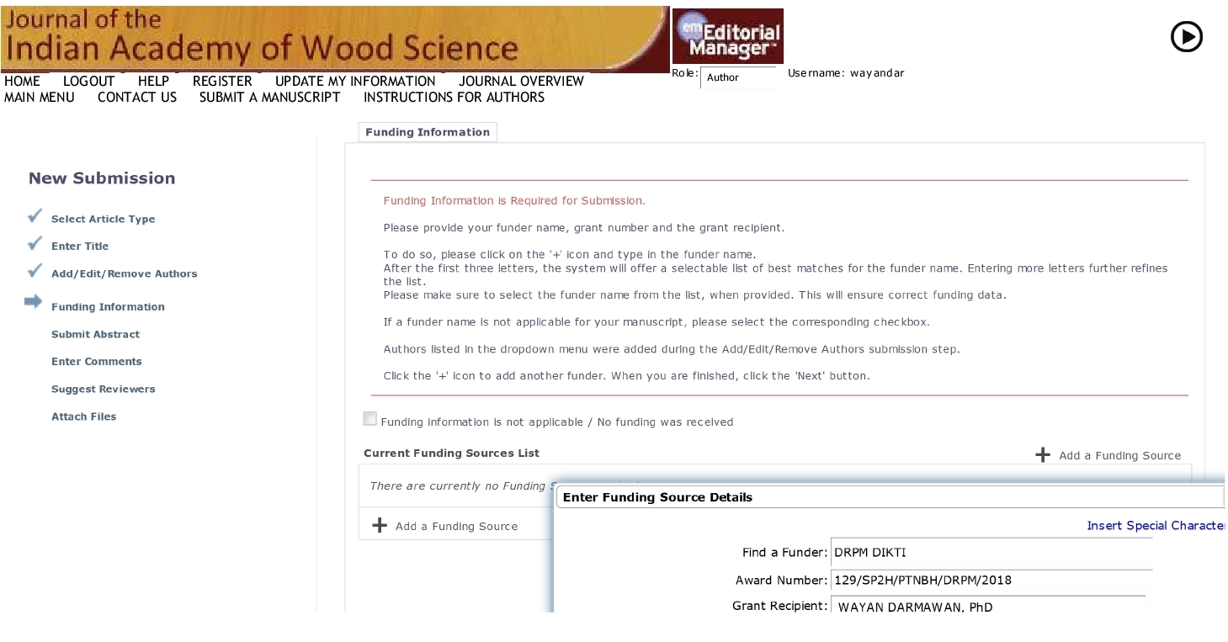

Slide 36
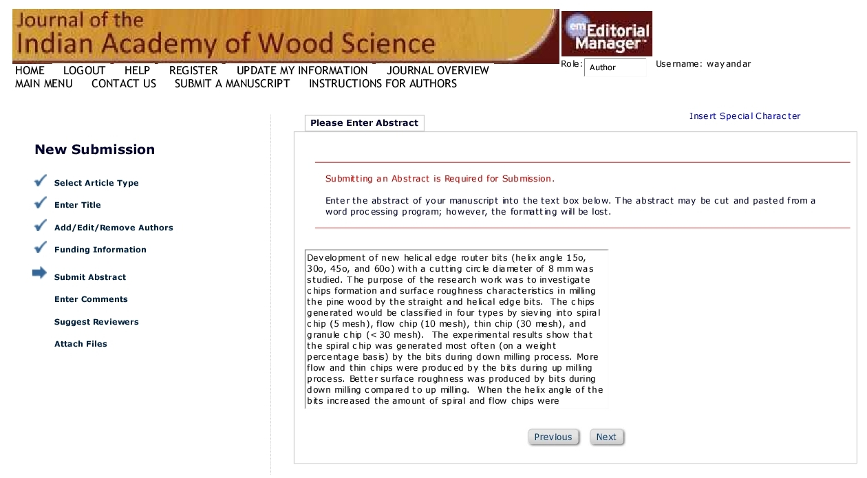

Slide 37
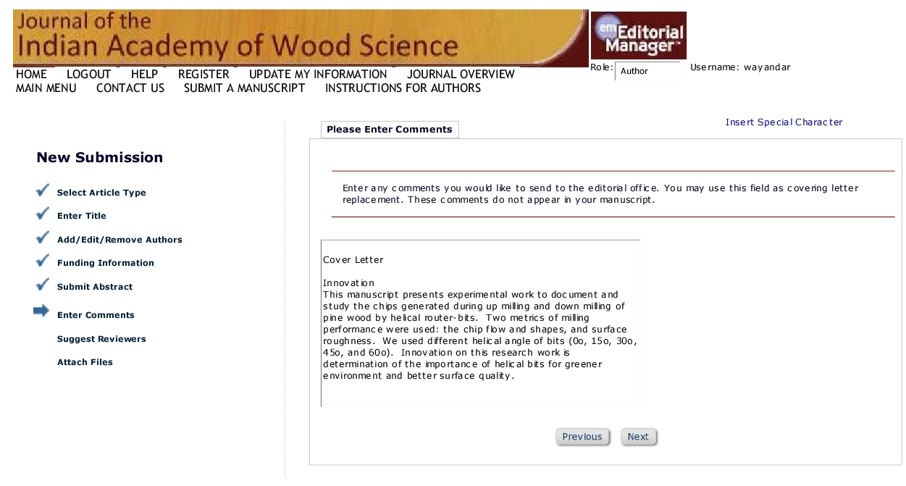

Slide 38
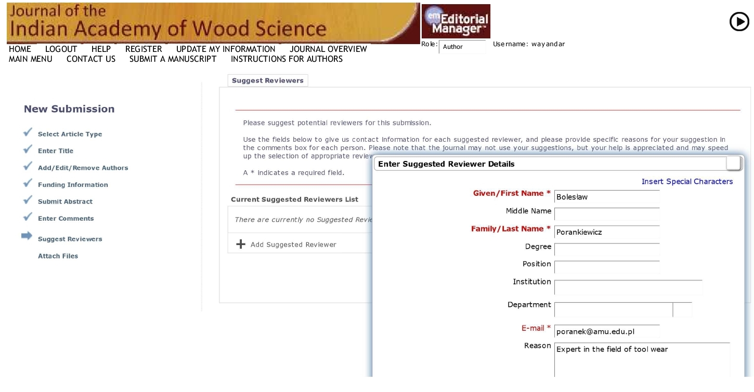

Slide 39
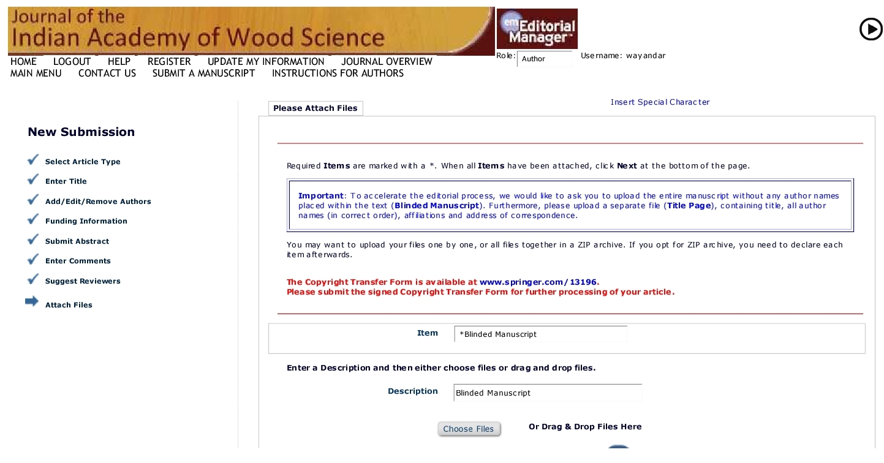

Slide 40
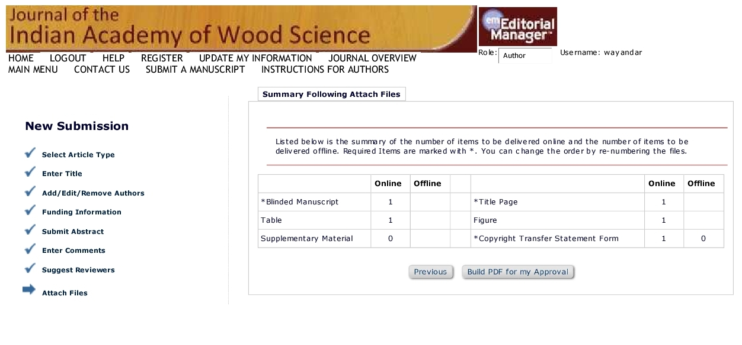

Slide 41
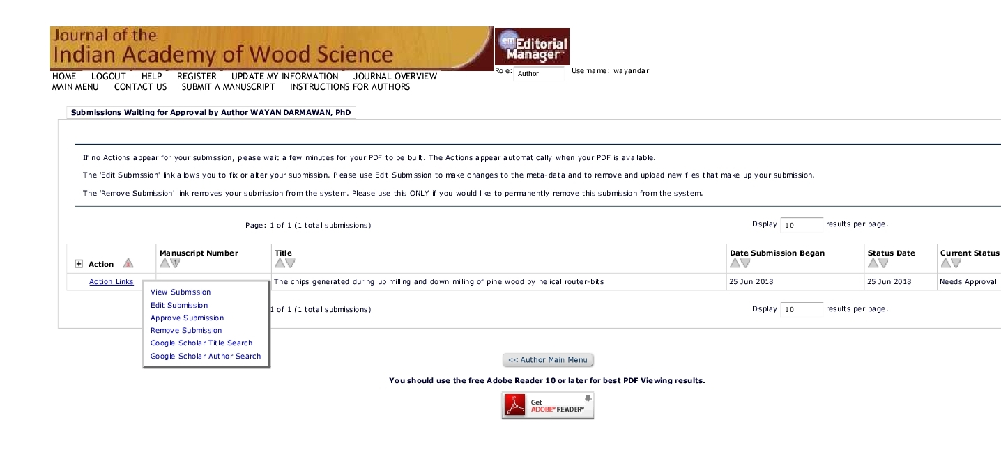

Slide 42
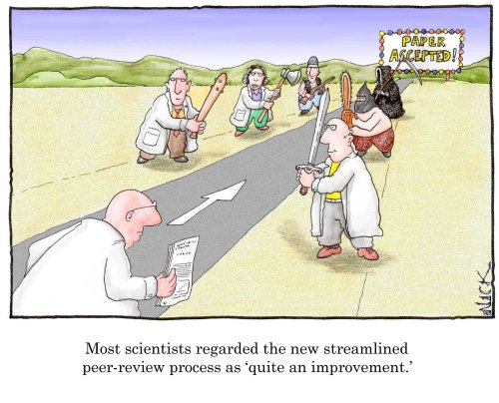
How To Get Your Article Published
4. Initial review by editorial
Why?
Editors wish to use reviewers only for those papers with a good probability of acceptance.
Many journals use a system of initial editorial review.
Editors may reject a manuscript without sending it for review

Slide 43
Editors may reject a manuscript without sending it for review
Content
Paper is of limited interest and is a routine application of well-known methods
The work presented in the article is out of the scope of the journal
Novelty and significance are not immediately evident or sufficiently well-justified
Preparation
Failure to meet submission requirements
Incomplete coverage of literature
Unacceptably poor English

Slide 44
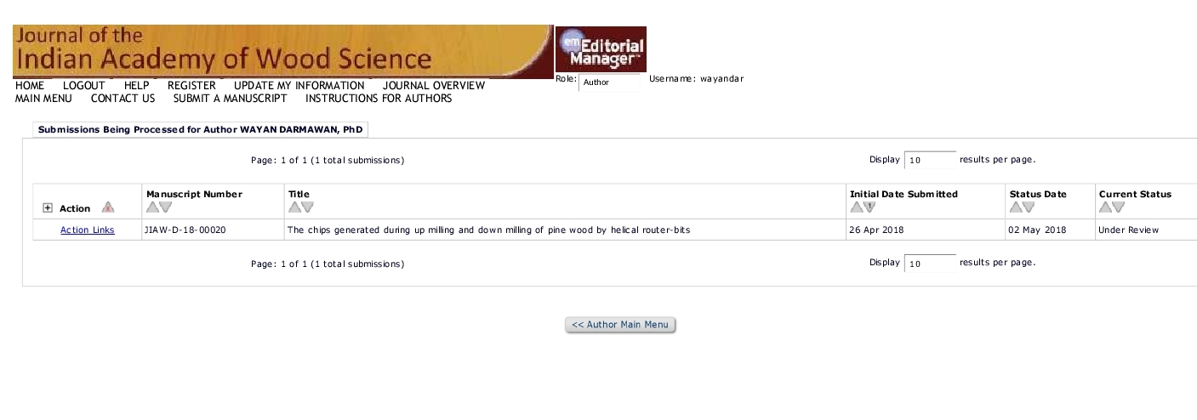
5. Review by peers

Slide 45
5.1 Reviewing as a procedure
Nearly every manuscript requires revision.
Keep in mind that editors and reviewers mean to help you improve your article
Do not take offense.
Minor revision does NOT guarantee acceptance after revision.
Do not count on acceptance, but address all comments carefully
Revise the manuscript by considering one by one of the reviewers comments

Slide 46
5.2 Revision after submission
Carefully study the comments and prepare a detailed letter of response.
Cut and paste each comment by the reviewer. Answer it directly, do not miss any point. Give page and line number
State specifically what changes you have made to the manuscript considering the comment. With different color.
Provide a scientific response to the comment you accept
or a convincing, solid and polite rebuttal to the point you think the reviewer is wrong.
Notes:
46
Do no hang on there too long. We will explain these three main points in the coming slides.

Slide 47
5.3 letter of response
CLARIFICATION for the REVIEWERS:
I appreciate much for your corrections and suggestions for improving the contents of our article. I have included some information considering your ideas and made some corrections in the texts. The corrected parts are indicated by red color in the text File. I am pleased to provide you some clarifications referring to your suggestions and comments as follows:

Slide 48
For Editor in Chief
Q1. We would like to make more scientific communication between our society members through the citation of each others’ papers. Please contain some relevant papers, which were published in JKWST, in your REFERENCE.
A1. It is valuable suggestion to put some relevant JKWST articles in our references. We found some JKWST articles and quoted in our article.
Seo, J. W., Eom, C. D., Park, S. Y. 2014. Study on the Variations of Inter-annual Tracheid Length for Korean Red Pine from Sokwang-ri in Uljin. J. Korean Wood Sci. Technol. 42(6): 646-652, quoted at Page 2 lines 55-57
Kwon, O., Lee, M. R., Eom, C. D. 2013. Utilization of Light Microscopy and FFT for MFA Measurement from Unstained Sections of Red Pine (Pinus densiflora). J. Korean Wood Sci. & Tech. 41(5):399-405, quoted at Page 3 lines 83-86
Kim, D.W., Hwang S. W., Lee, W. H. 2014. A Study on The Mechanical Properties of Korean Red Pine (Geumgangsong, Pinus densiflora forma erecta Uyeki). J. Korean Wood Sci. & Tech. 42(1): 58-67, quoted at Page 10 lines 310-314
Lee, A. H., Jang, J. H., Hwang, W. J., KIM, N. H. 2017. Decay and Termite Resistance of Yellow-Hearted Pine (Pinus densiflora for. erecta Uyeki)J. Korean Wood Sci. Technol. 45(1): 12-19, quoted at Page 12 lines 372-377

Slide 49
For Reviewer #1:
Q1. Page 1, It is good to have a clear goal statement for the study, weather the author want to analyze the characteristics of anatomical features along the growth rings or author want to study of the properties of the species for furniture.
A1. I rewrote the clear purpose of the research work (in page 1, lines 16-19). The purpose of this study was to investigate the occurrence of juvenile and mature on the Merkusii pine wood and to analyze its radial features based on density, shrinkage, static bending in modulus of rupture and modulus of elasticity, fiber length, microfibril angle, and durability.

Slide 50
5.4 Re-Submitting
As the REVISION was complete
And
the Letter of Response was prepared
Then
Submitting the REVISION and Letter
Online through the Journal LOGIN

Slide 52
5.5 NOTE for REJECTED Manuscript!
Never resubmitting a rejected manuscript directly to another journal without any significant revision
The original reviewers (even editors) may eventually find it, which can lead to animosity towards the author.
A possible strategy
In your cover letter, declare that the paper was rejected and name the journal.
Include the referees’ reports and a detailed letter of response, showing how each comment has been addressed.
Explain why you are resubmitting the paper to this journal : e.g.
this journal is a more appropriate journal;
the manuscript has been improved as a result of its previous review
Notes:
52
Haddad

Slide 53
6. Important to remember
Preparation is important but do not spend too much time on your preparations
Submit to the right journal (scope and prestige)
Submit to one journal only
Check the English
Pay attention to structure
Pay attention to journal requirements
Be honest

Slide 54
Questions?
Or for questions later, please contact : wayandar@indo.net.id

Slide 55
TERIMAKASIH

